Slide 1
Micro Credit Loan Use Case
Lalbiak zauva

Slide 2
Problem Statement
A Microfinance Institution (MFI) is an organization that offers financial services to low-income populations. MFS becomes very useful when targeting especially the unbanked poor families living in remote areas with not much sources of income. The Microfinance services (MFS) provided by MFI are Group Loans, Agricultural Loans, Individual Business Loans and so on.
Many microfinance institutions (MFI), experts and donors are supporting the idea of using mobile financial services (MFS) which they feel are more convenient and efficient, and cost saving, than the traditional high-touch model used since long for the purpose of delivering microfinance services. Though, the MFI industry is primarily focusing on low-income families and are very useful in such areas, the implementation of MFS has been uneven with both significant challenges and successes.
Today, microfinance is widely accepted as a poverty-reduction tool, representing $70 billion in outstanding loans and a global outreach of 200 million clients. We are working with one such client that is in Telecom Industry. They are a fixed wireless telecommunications network provider. They have launched various products and have developed its business and organization based on the budget operator model, offering better products at Lower Prices to all value conscious customers through a strategy of disruptive innovation that focuses on the subscriber.

Slide 3
Problem Statement
They understand the importance of communication and how it affects a person’s life, thus, focusing on providing their services and products to low-income families and poor customers that can help them in the need of hour.
They are collaborating with an MFI to provide micro-credit on mobile balances to be paid back in 5 days. The Consumer is believed to be defaulter if he deviates from the path of paying back the loaned amount within the time duration of 5 days. For the loan amount of 5 (in Indonesian Rupiah), payback amount should be 6 (in Indonesian Rupiah), while, for the loan amount of 10 (in Indonesian Rupiah), the payback amount should be 12 (in Indonesian Rupiah).
In order to improve the selection of customers for the credit, the client wants some predictions that could help them in further investment and improvement in selection of customers.

Slide 4
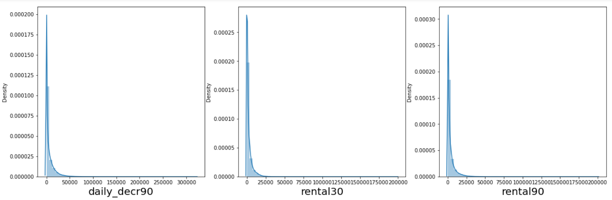
Data Analysis
There are no null values in the dataset.
All the data are int64 or float64 data type, so no need of encoding the data.
Our target variable “label” is a categorical data.
There are data which cannot exist and they are handled. Some data has negative values which is not possible. So, they are converted into positive values.
The data is highly skewed as we can see below and they are treated using PowerTransformer

Slide 5
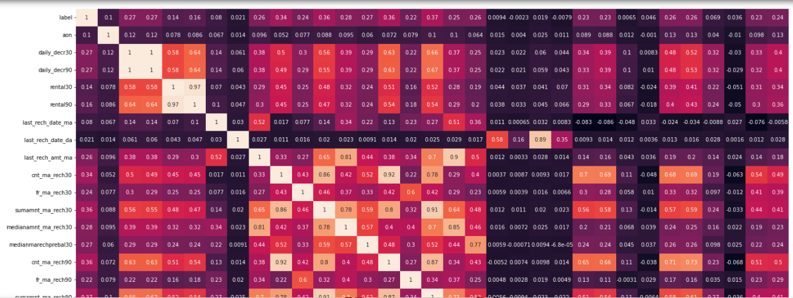
Data Analysis
A heatmap is plotted to see multicollinearity. Turns out that we can remove ‘daily_decr30’ column since there is multicollinearity.

Slide 6
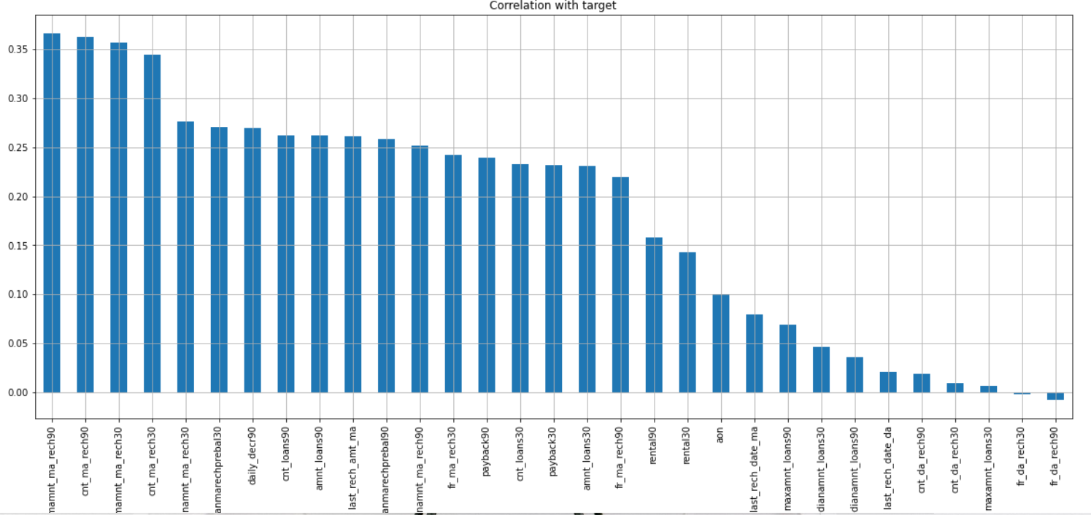
Data Analysis
A correlation between the features and label is plotted and most of the features has positive correlation with label.

Slide 7
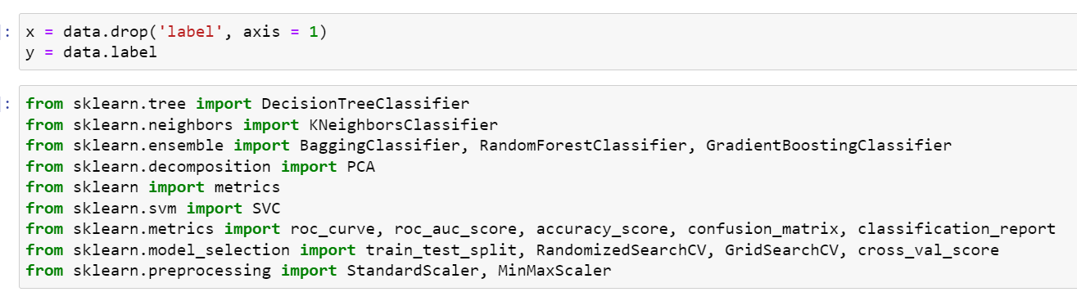
Model Building
Split the data into train and test and import necessary libraries.

Slide 8
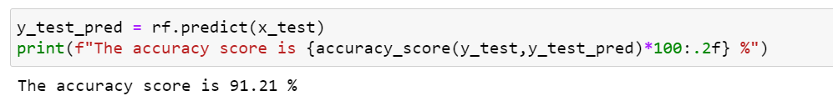
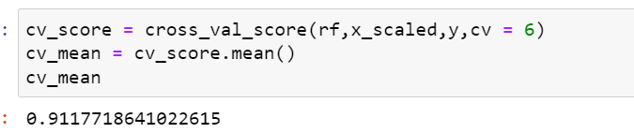
Conclusion
Out of different algorithms, RandomForestClassifier gives the best accuracy of 91.2%.
Cross Validation score was checked to see if the model is overfitting or not. The cross val score is 91.1% which shows that our model is not overfitting.

